Slide 1
Baby Names and Culture Popularity
Andrew Pistole
James Bain
Keevey Song
Rasha Gargees
Peng Zhao

Slide 2
Contents
Intro to the 5 Datasets

Slide 3
The Datasets Datasets
Baby Names
Sports
Presidents
Movie Characters
Disney Characters

Slide 4
Questions
Overarching Question
Do popular figures in American society shape the baby naming landscape?
Inspiration
In previous analyses performed on Kaggle, we saw that some US Presidents had spikes in their names during campaigning years. Could this trend be applied to other cultural milieus? Does the Presidential trend keep influencing baby names throughout their Presidency?
Explored Questions
Does the approval rating of a President correlate to the prevalence of babies named after them?
Do the Disney Characters influence the baby names?
Do the sport MVPs have influence on the baby names?
Do characters in successful movies influence baby names after the release?

Slide 5
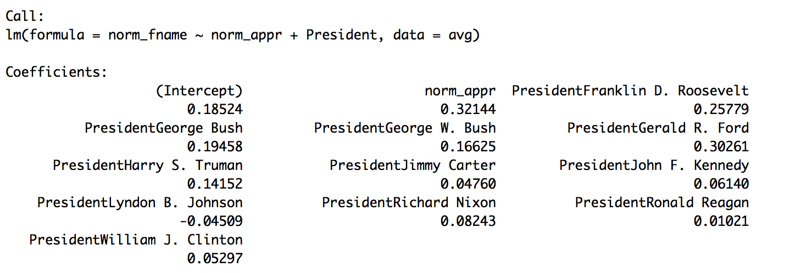
Baby Name Popularity vs President’s Approval
Question: Does the approval rating of a President influence the rate of babies named after them?
A quick analysis: first name rate (normalized) ~ approval rating (normalized) + President

Slide 6
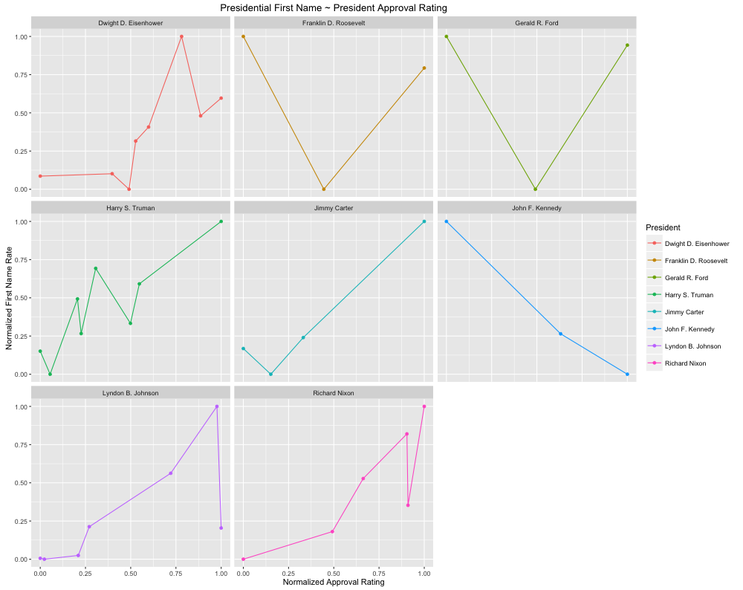
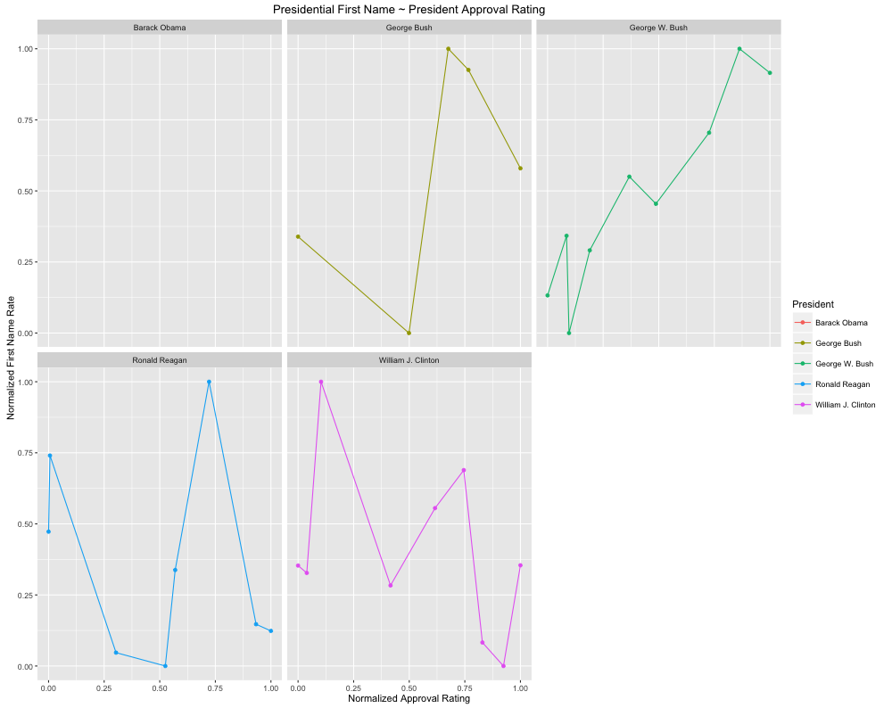
Baby Name Popularity vs President’s Approval

Slide 7
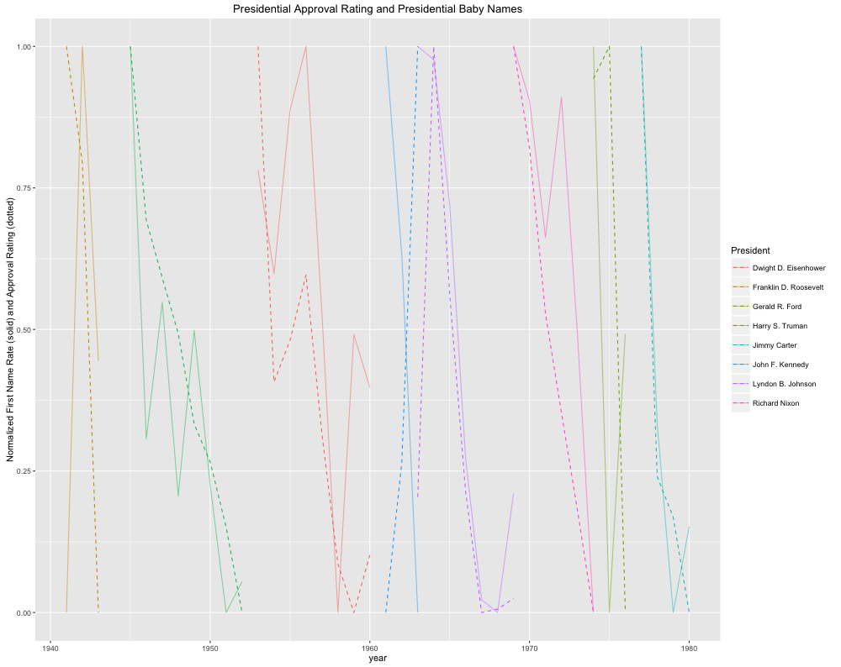
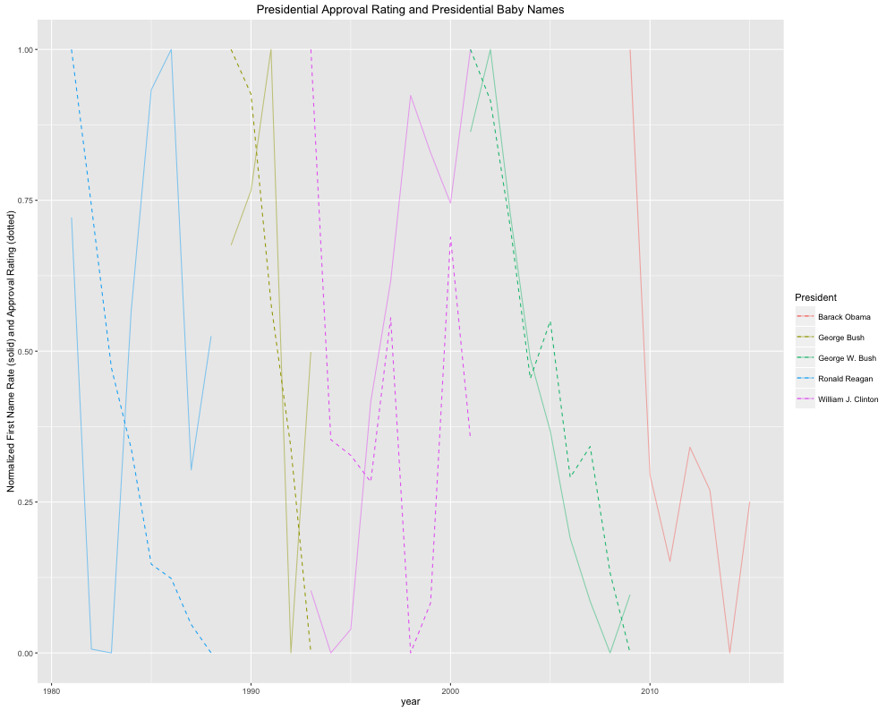
Baby Name Popularity vs. Presidential Approval

Slide 8
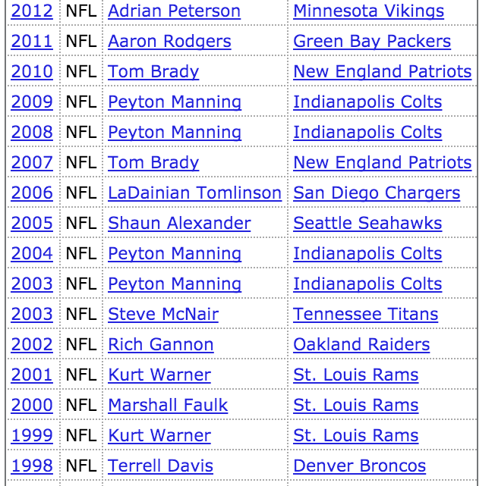
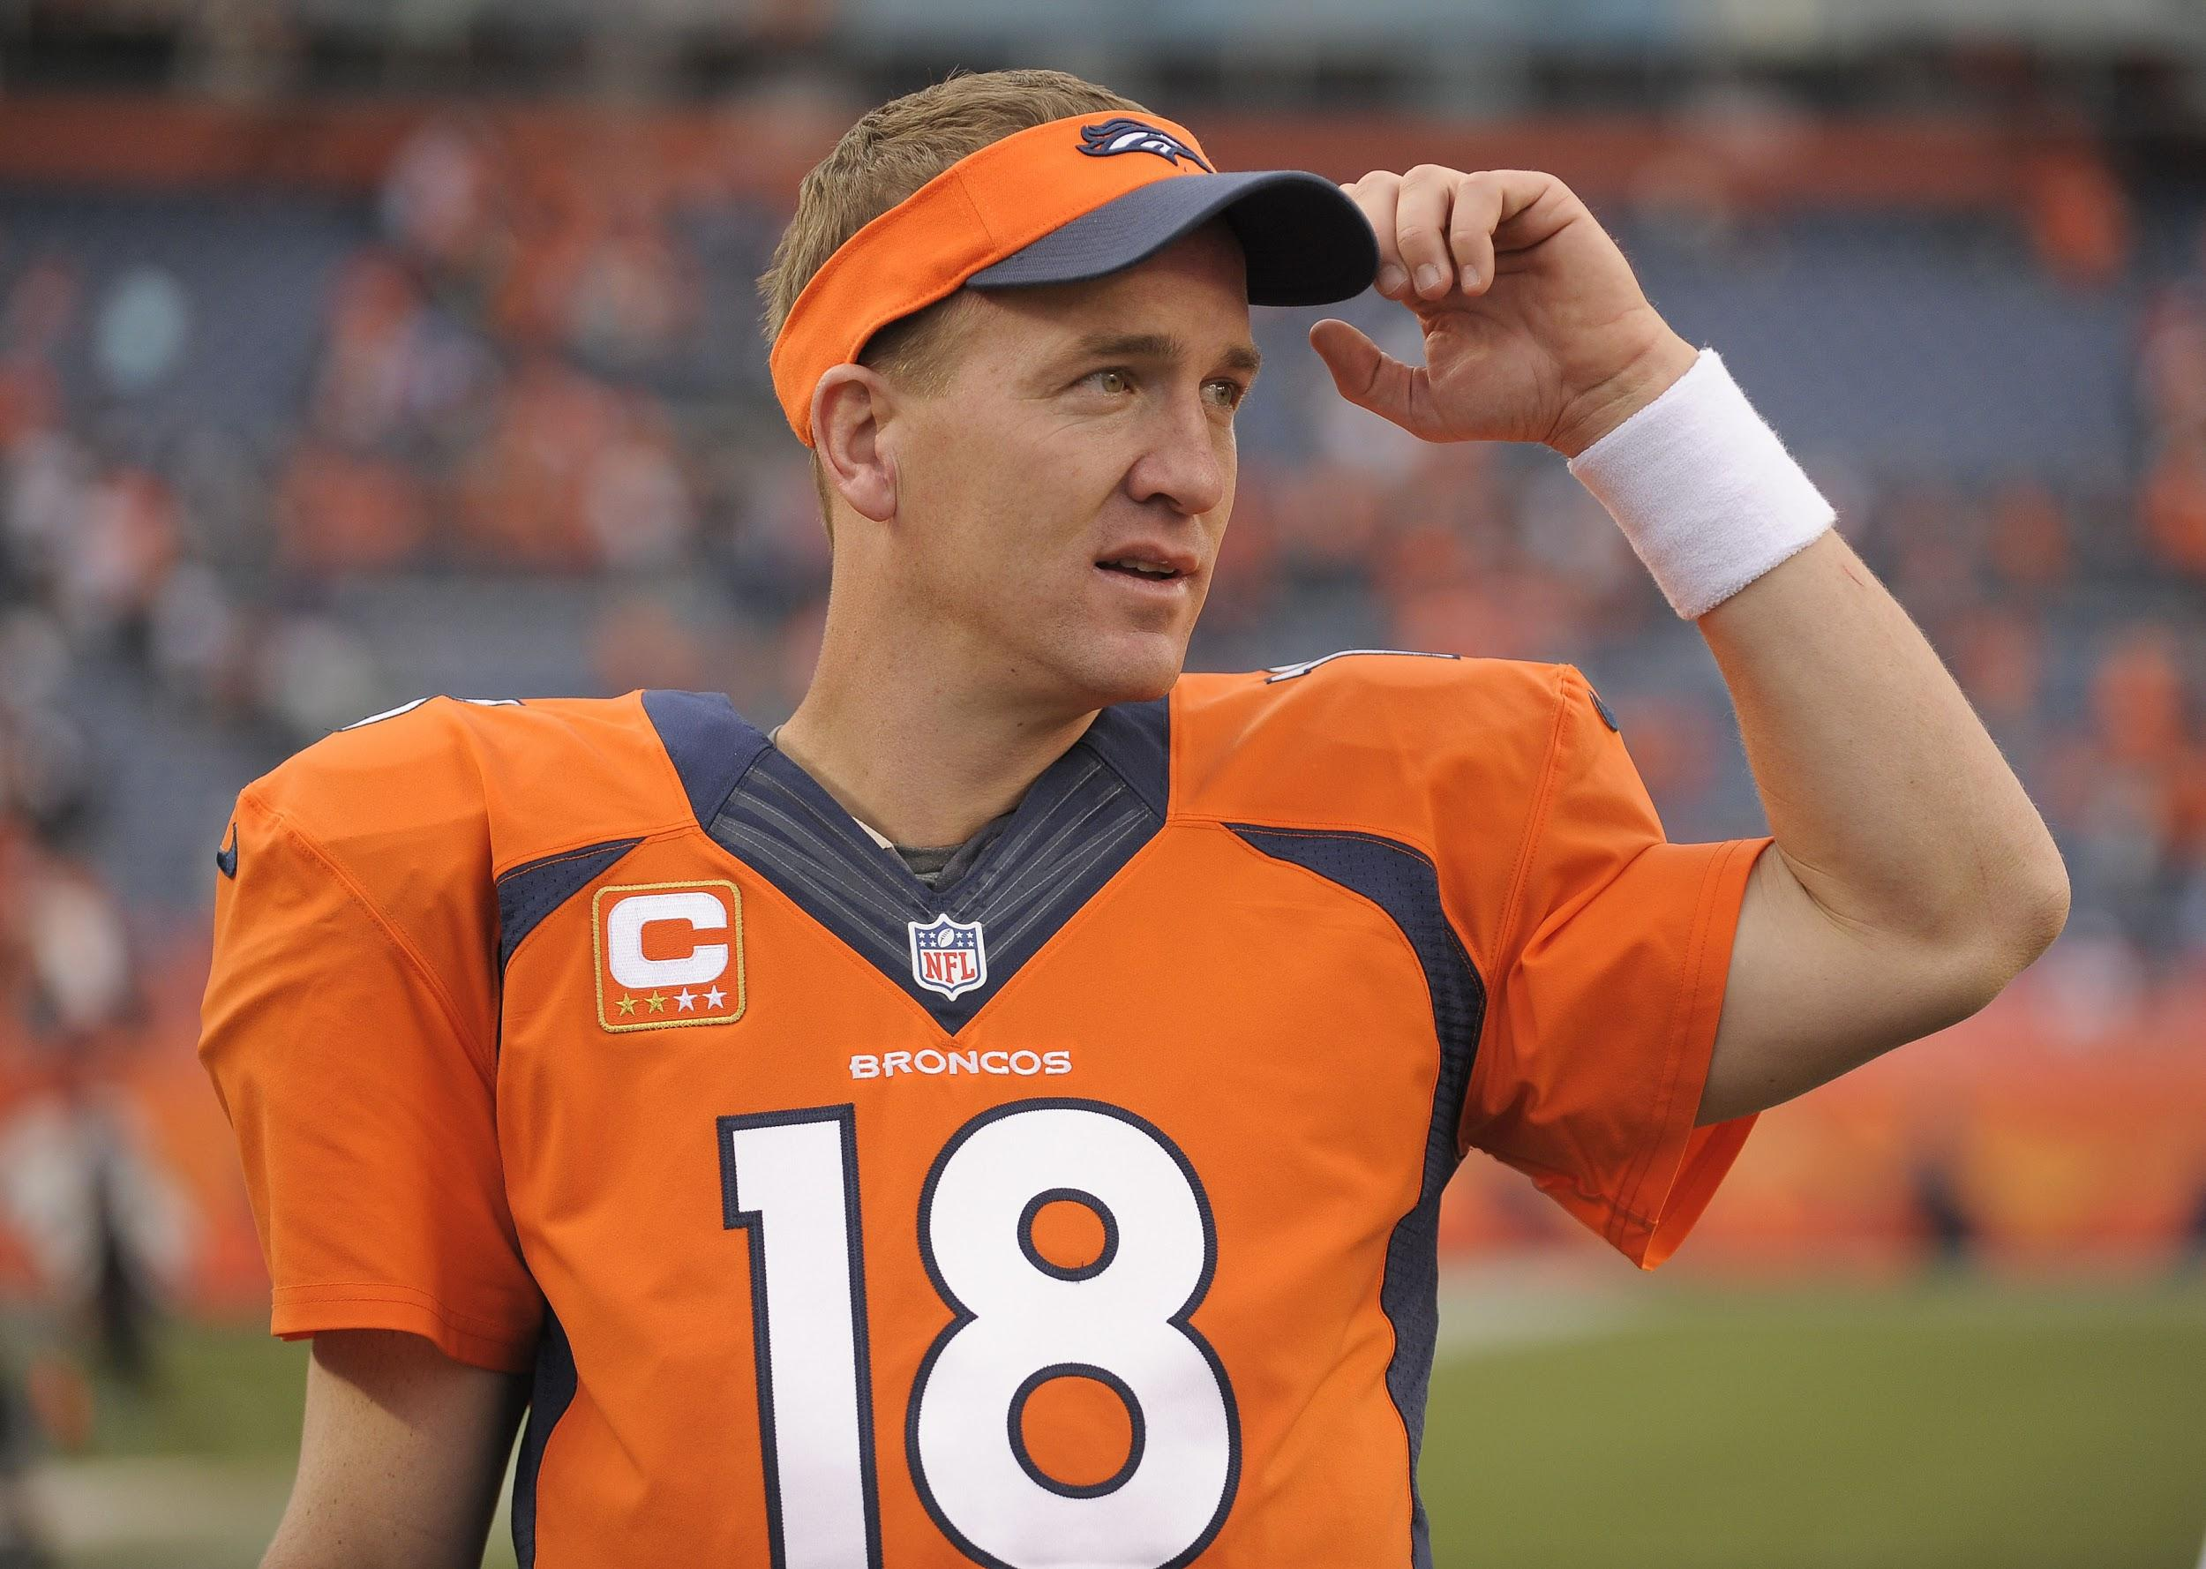
Baby Name Popularity vs Sport MVP’s

Slide 9
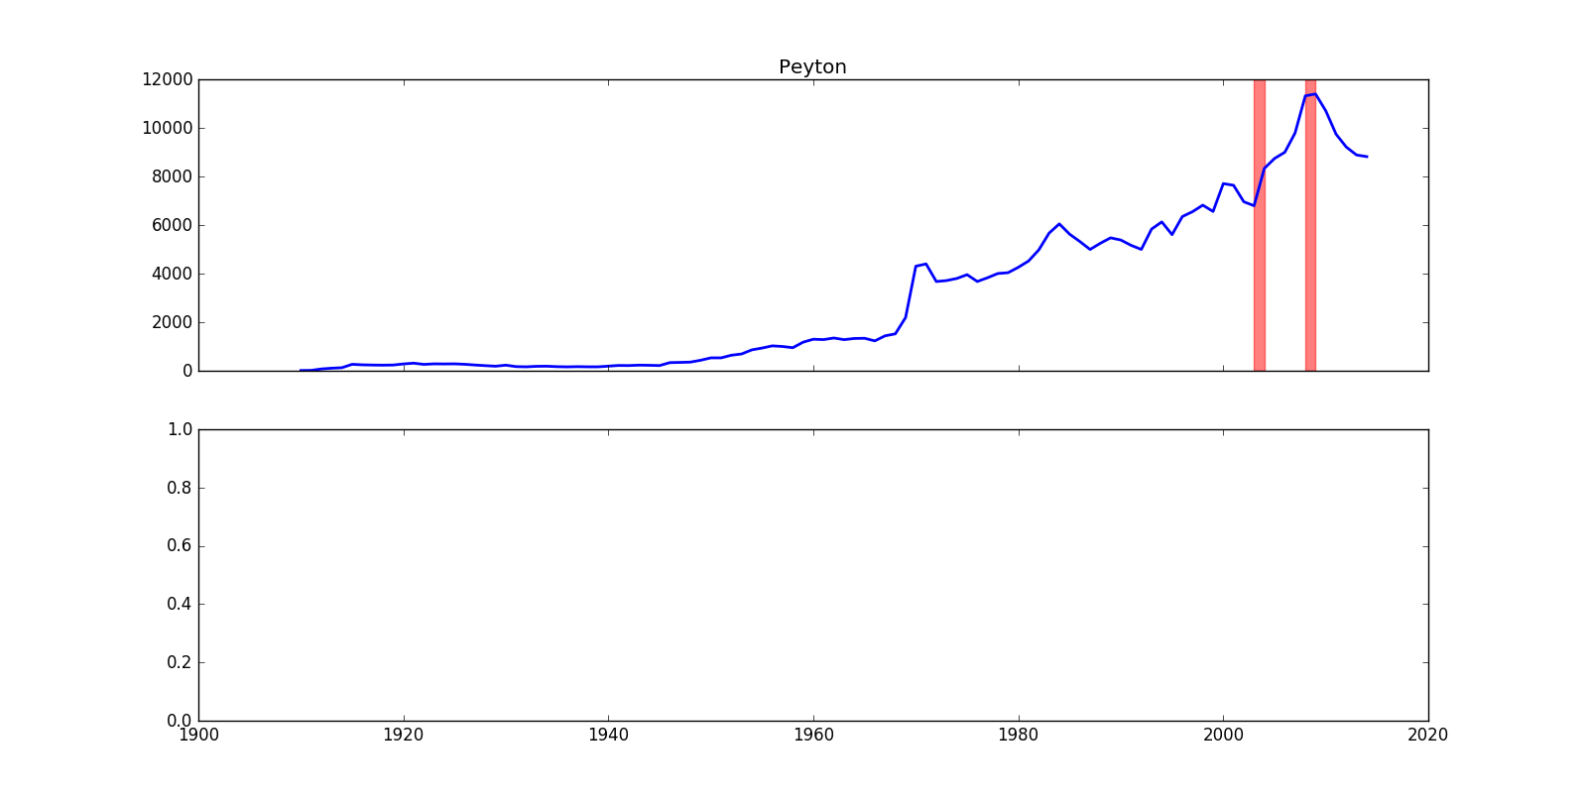
Baby Name Popularity vs Sport MVP’s

Slide 10
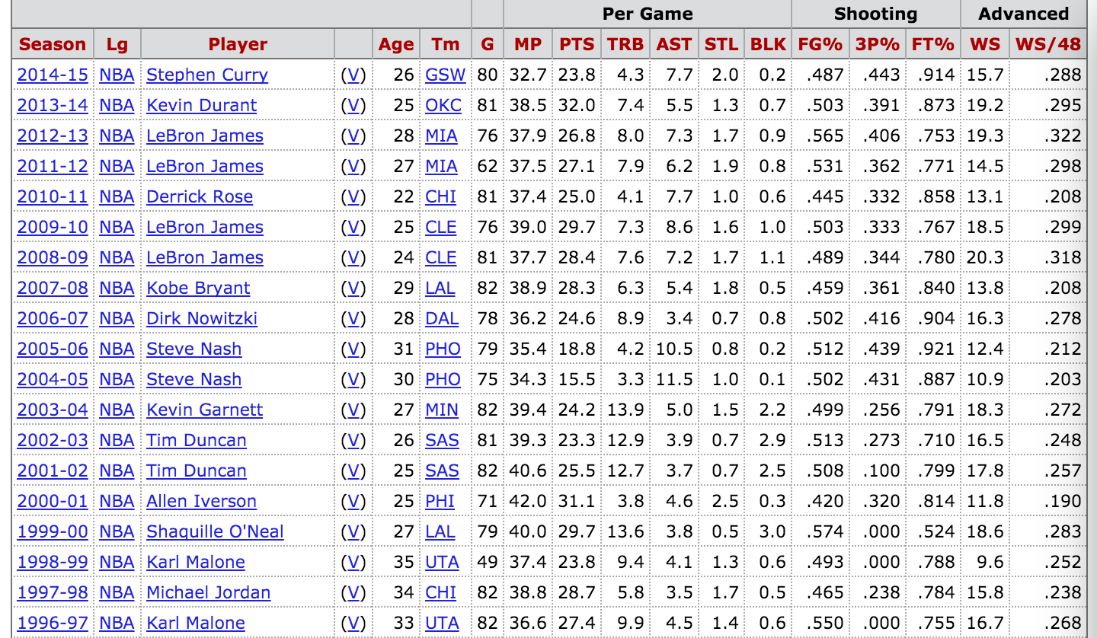
Baby Name Popularity vs Sport MVP’s

Slide 11
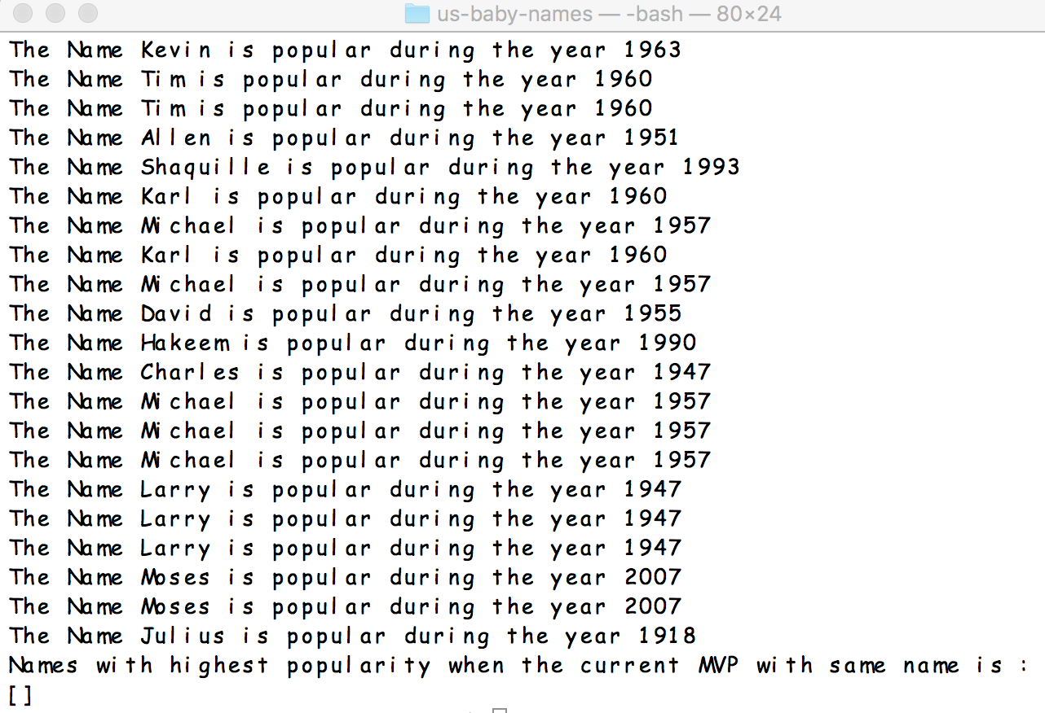
Baby Name Popularity vs Sport MVP’s

Slide 12
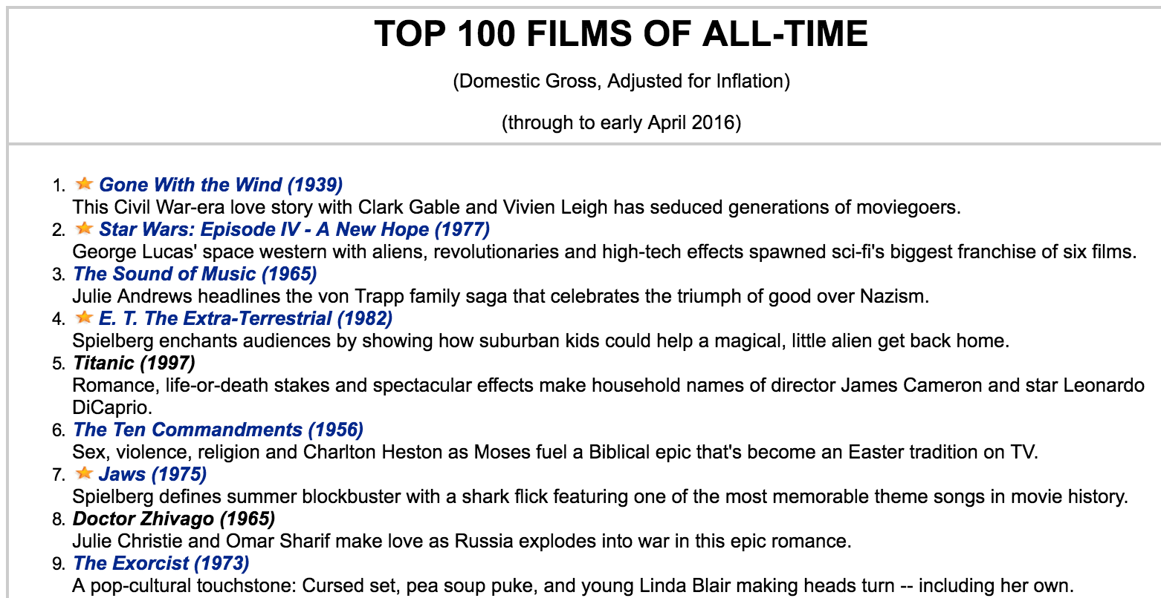
Baby Name vs Movie Characters
Data Source
Top 100 movies of all time adjusted for inflation
It lacks the information of characters and cast
http://www.filmsite.org/boxoffice3.htmlCreate

Slide 13

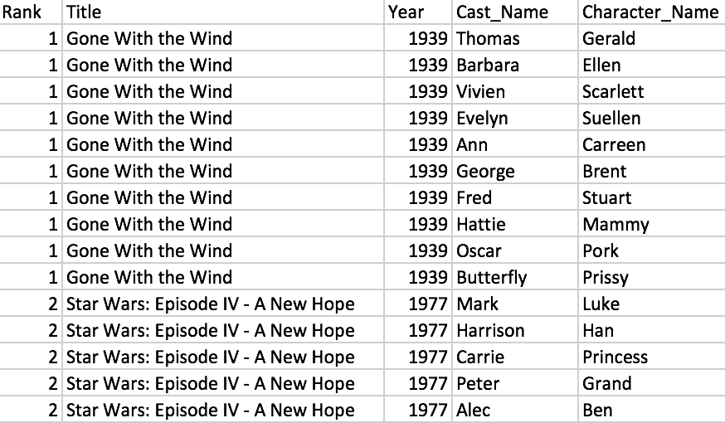
Baby Name vs Movie Characters
Data Carpentry
The data was cleaned and integrated with characters and cast information from IMDb through IMDbPY package

Slide 14
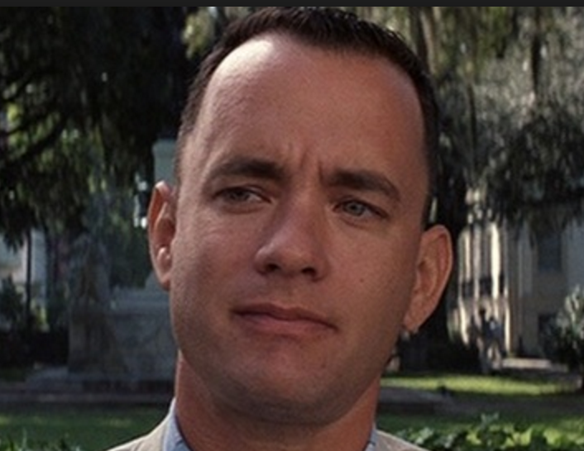
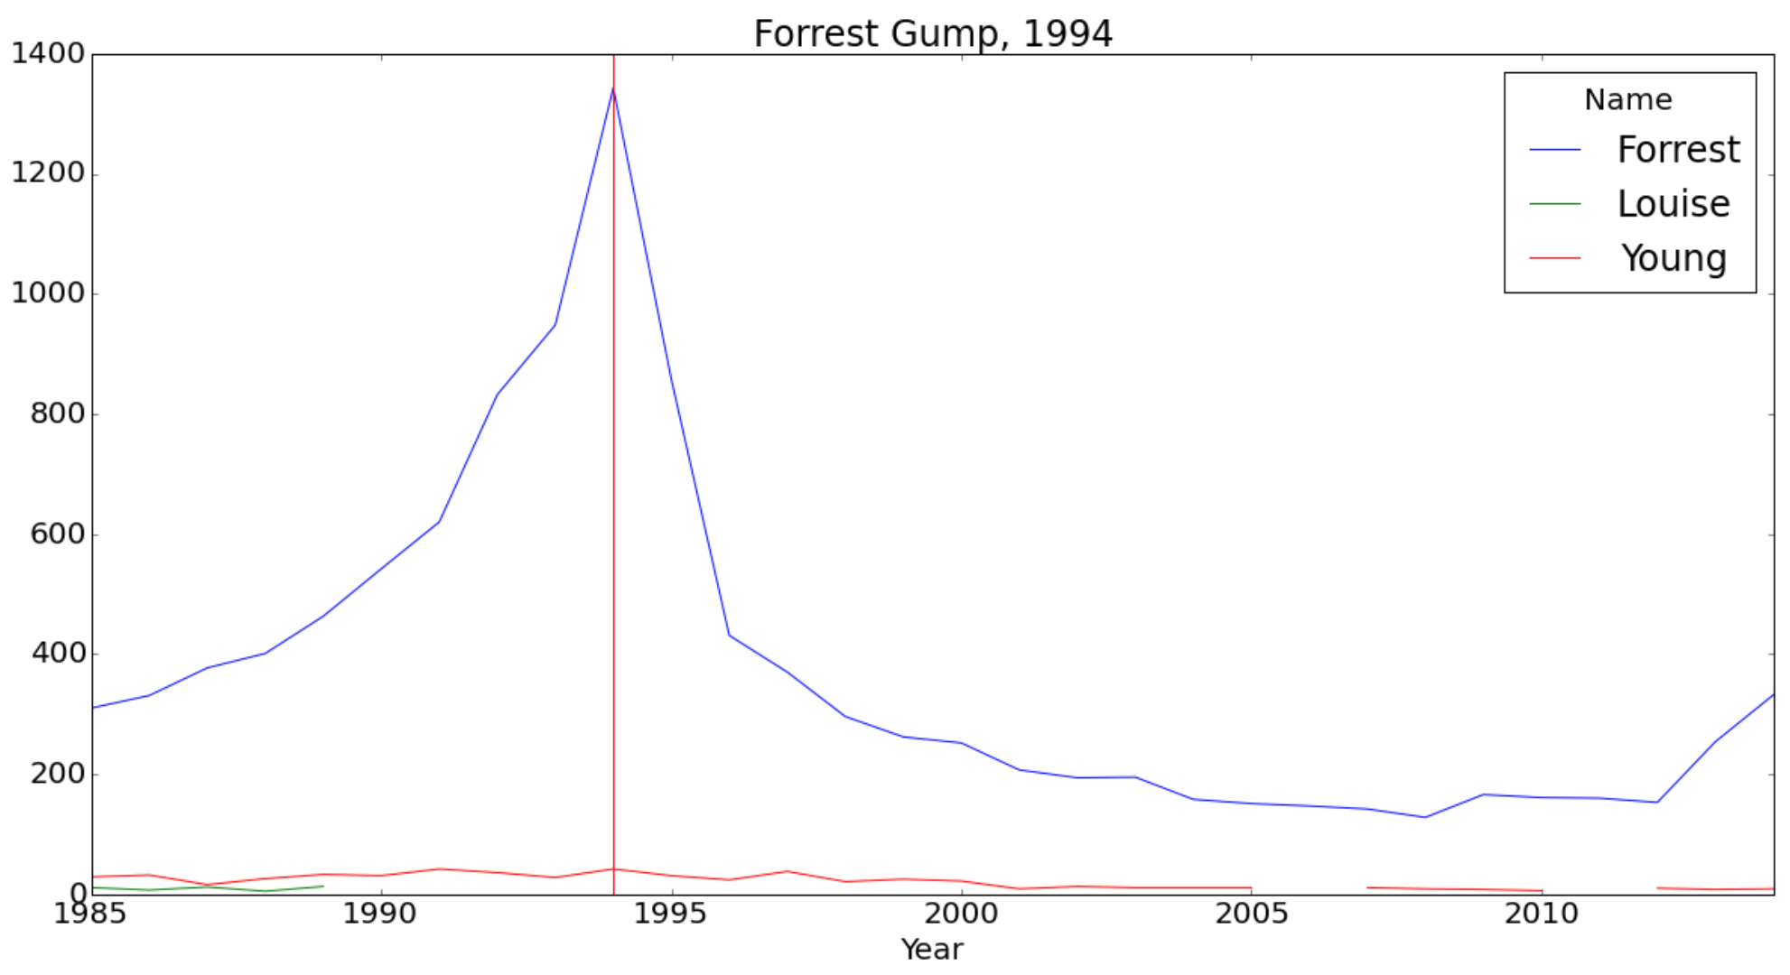
Baby Name vs Movie Characters
Forrest Gump
Forrest Gump 1994
There is an obvious spike for “Forrest” in 1994

Slide 15

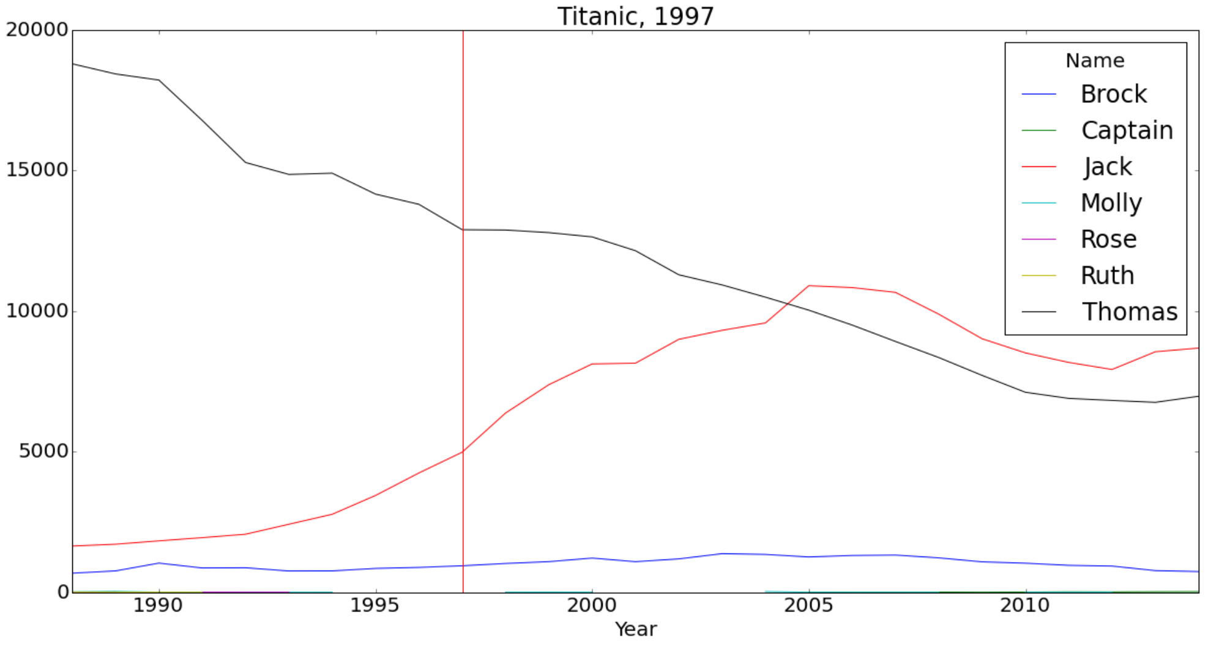
Baby Name vs Movie Characters
Jack Dawson
Titanic 1997
“Jack” is increasing but it’s hard to say if it’s influenced by the movie
“Jack” is a more common name and small spikes can be diluted by the large population base

Slide 16
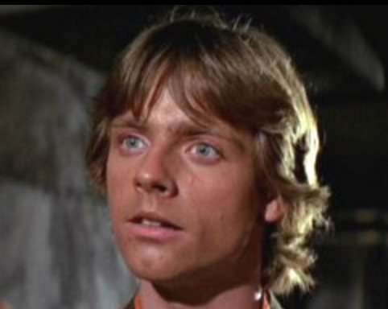
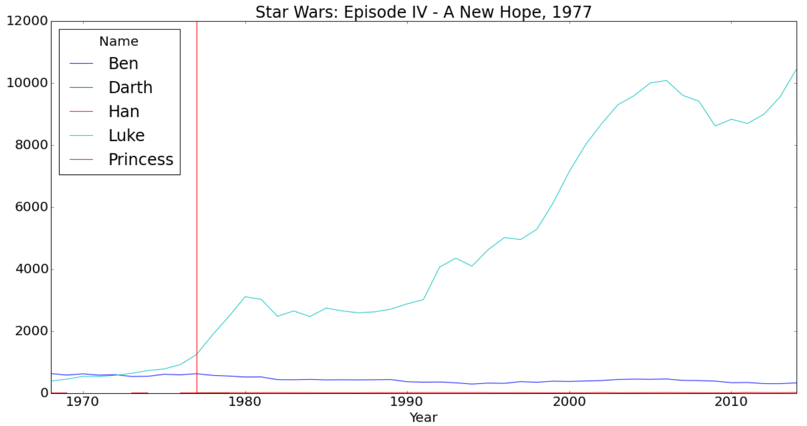
Baby Name vs Movie Characters
Luke Skywalker
Star Wars Episodes
IV - A New Hope 1977
V - The Empire Strikes Back 1980
VI - Return of Jedi 1983
I - The Phantom Menace 1999
II - Attack of the Clones 2002
III - Revenge of the Sith 2005
VII - The Force Awakens 2015

Slide 17

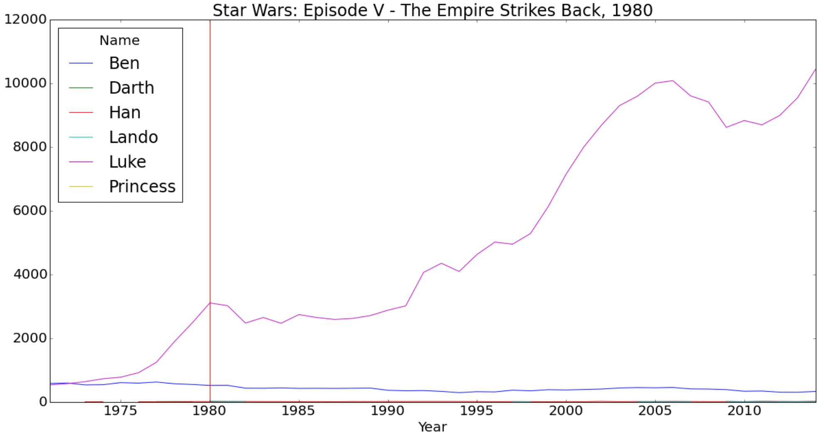
Baby Name vs Movie Characters
Luke Skywalker
Star Wars Episodes
IV - A New Hope 1977
V - The Empire Strikes Back 1980
VI - Return of Jedi 1983
I - The Phantom Menace 1999
II - Attack of the Clones 2002
III - Revenge of the Sith 2005
VII - The Force Awakens 2015

Slide 18
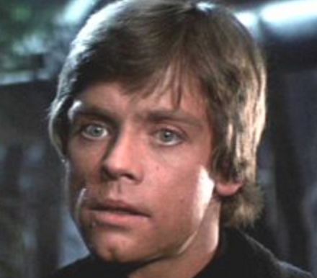
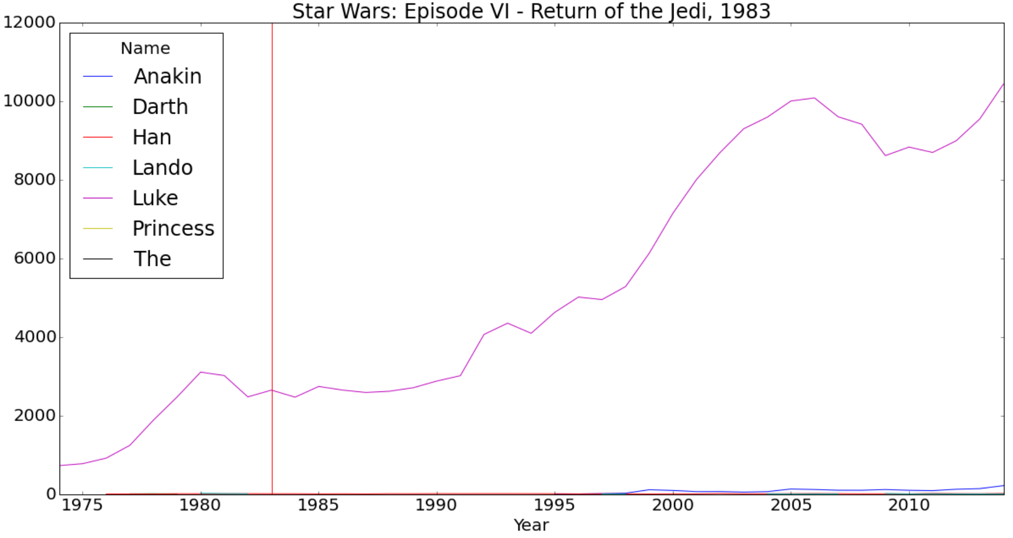
Baby Name vs Movie Characters
Luke Skywalker
Star Wars Episodes
IV - A New Hope 1977
V - The Empire Strikes Back 1980
VI - Return of Jedi 1983
I - The Phantom Menace 1999
II - Attack of the Clones 2002
III - Revenge of the Sith 2005
VII - The Force Awakens 2015

Slide 19
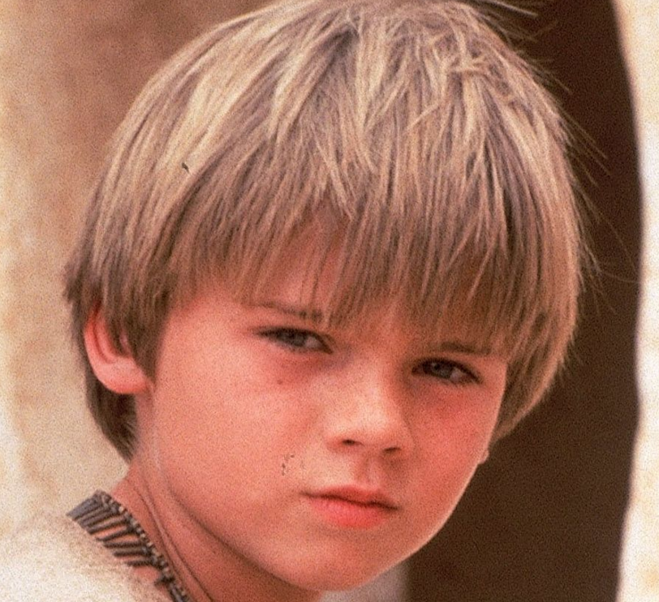
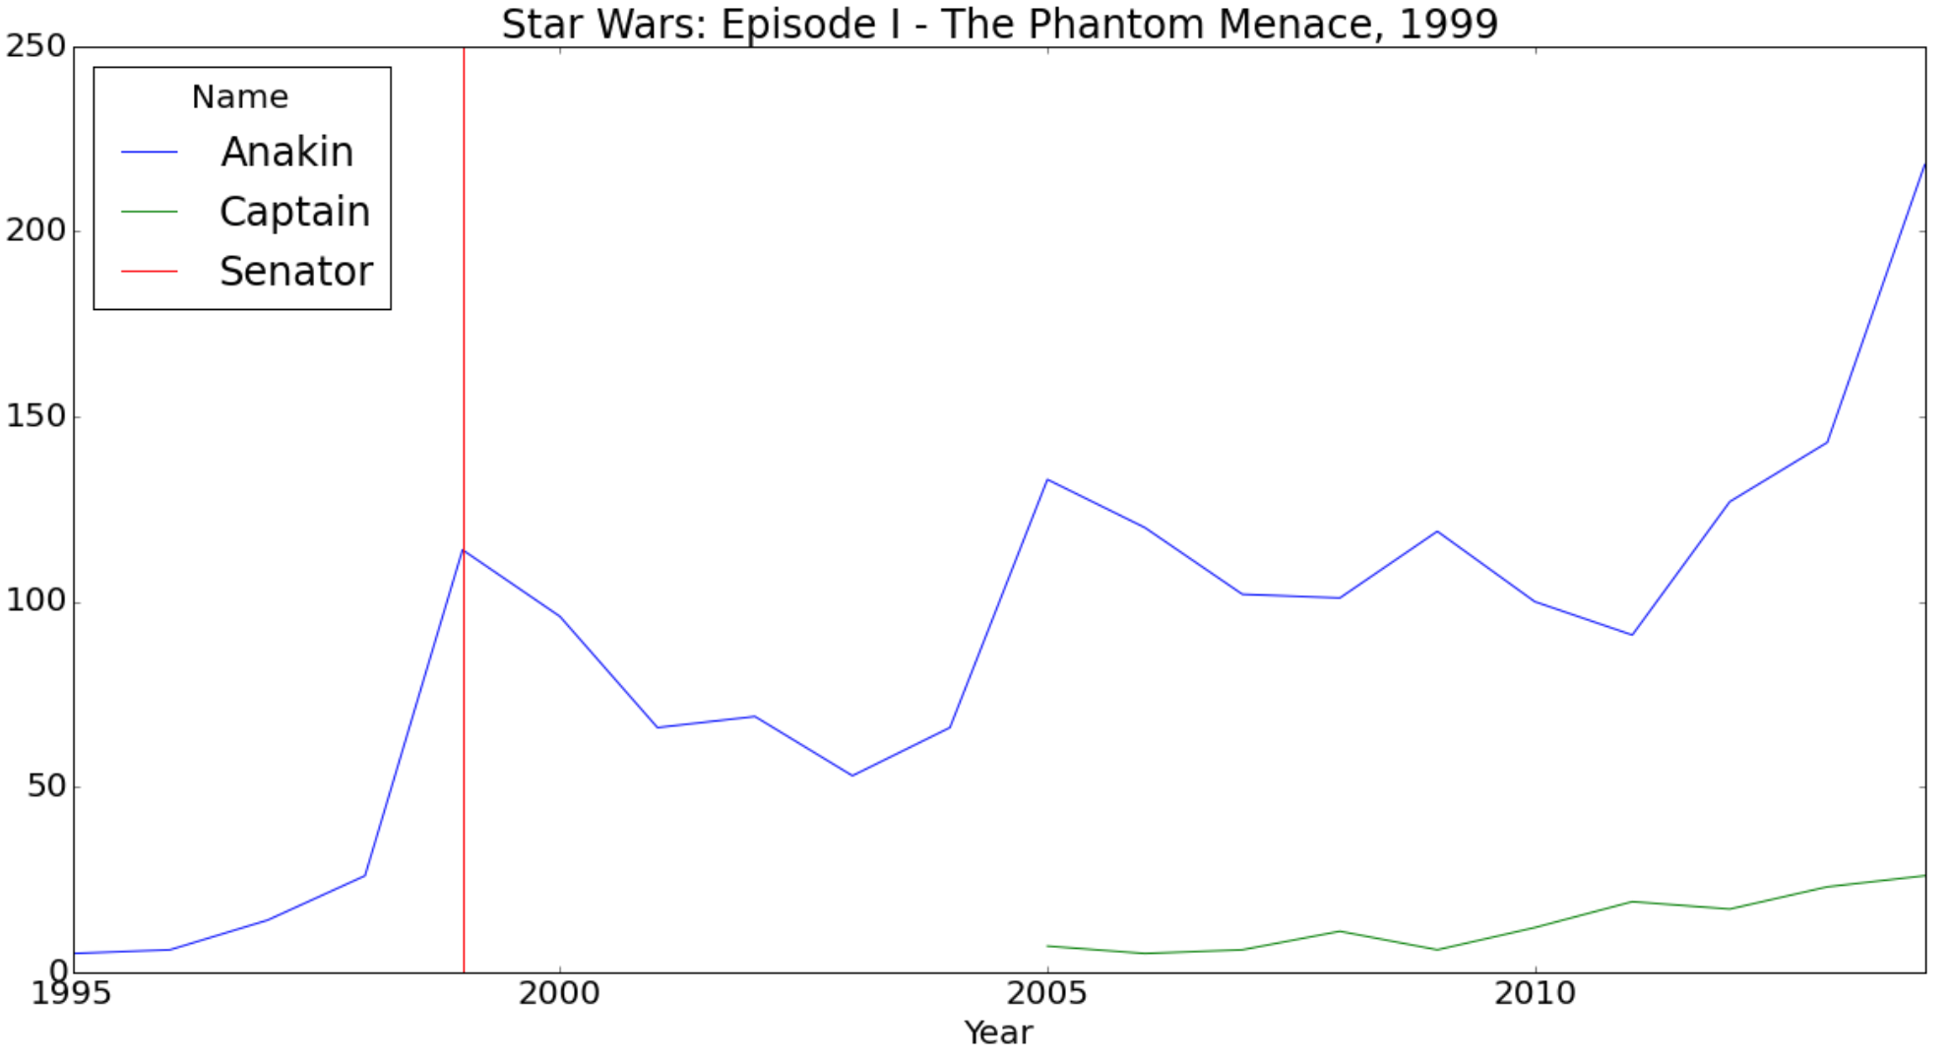
Baby Name vs Movie Characters
Anakin Skywalker
Star Wars Episodes
IV - A New Hope 1977
V - The Empire Strikes Back 1980
VI - Return of Jedi 1983
I - The Phantom Menace 1999
II - Attack of the Clones 2002
III - Revenge of the Sith 2005
VII - The Force Awakens 2015

Slide 20
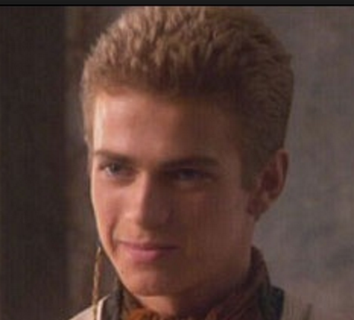
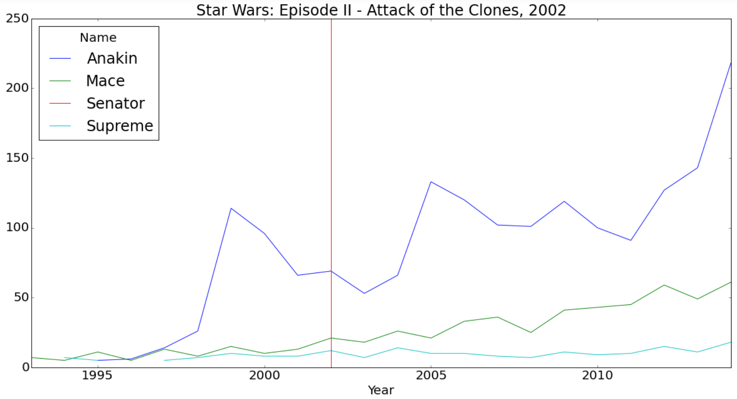
Baby Name vs Movie Characters
Anakin Skywalker
Star Wars Episodes
IV - A New Hope 1977
V - The Empire Strikes Back 1980
VI - Return of Jedi 1983
I - The Phantom Menace 1999
II - Attack of the Clones 2002
III - Revenge of the Sith 2005
VII - The Force Awakens 2015

Slide 21
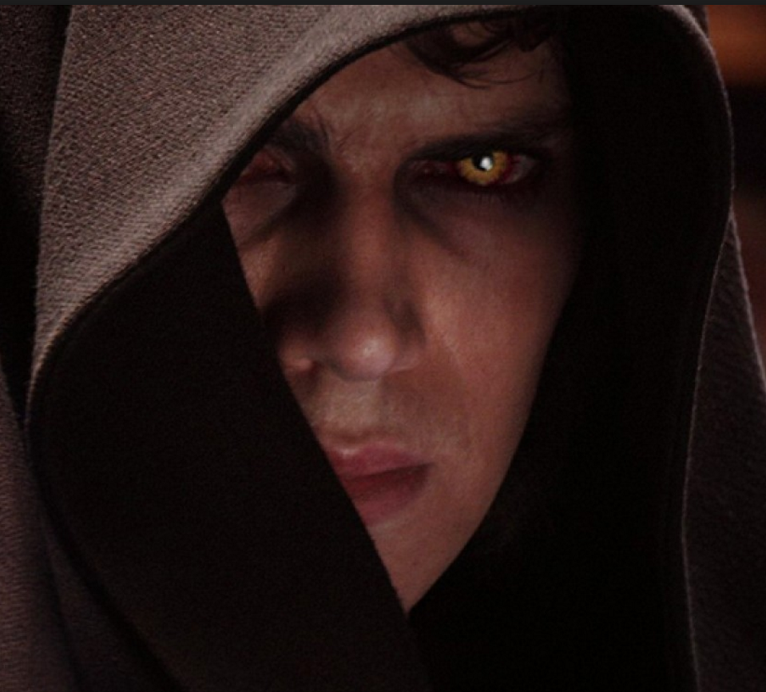
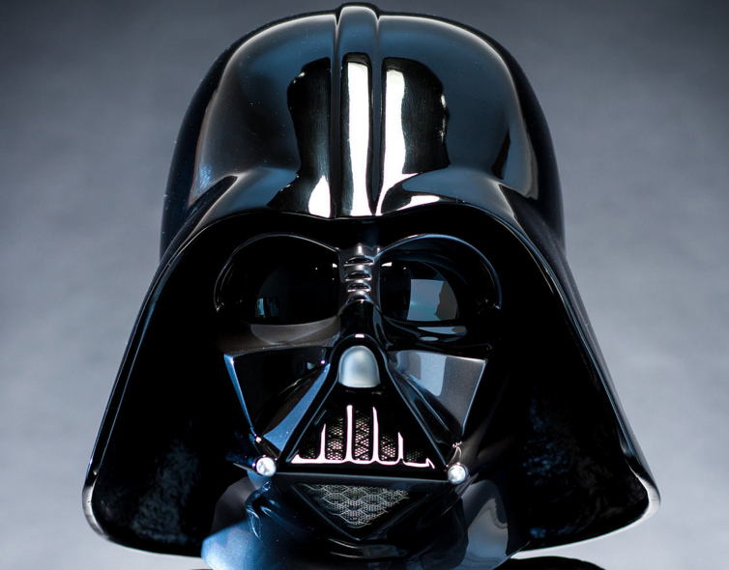
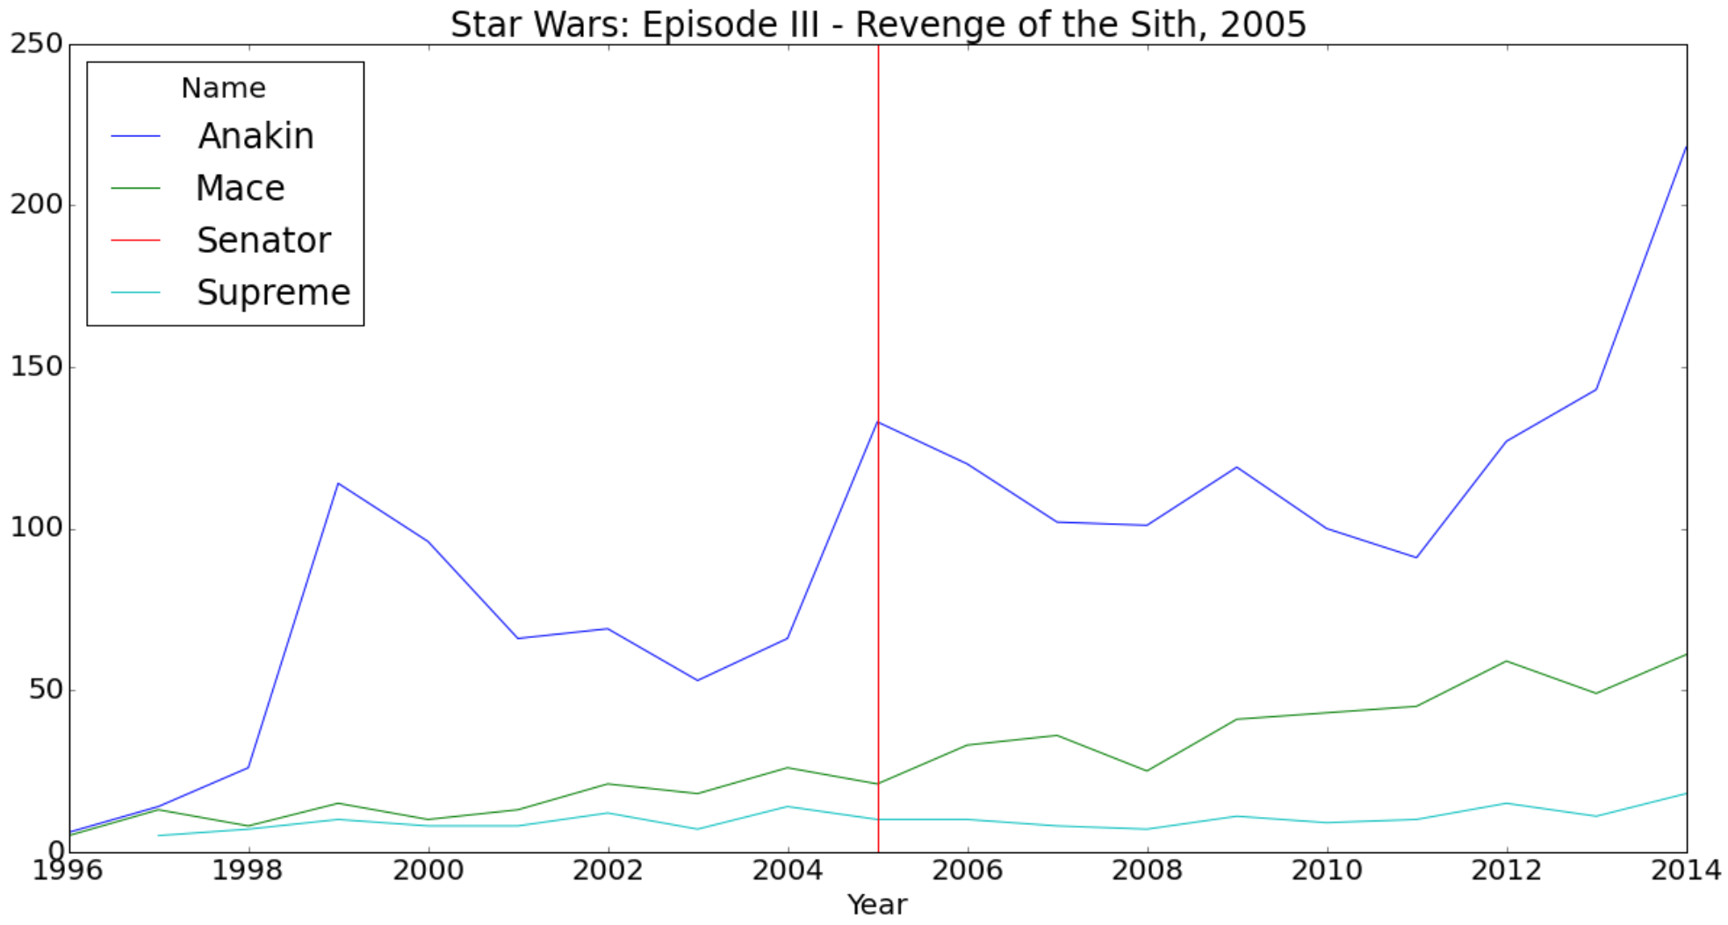
Baby Name vs Movie Characters
Anakin Skywalker
(Darth Vader)
Star Wars Episodes
IV - A New Hope 1977
V - The Empire Strikes Back 1980
VI - Return of Jedi 1983
I - The Phantom Menace 1999
II - Attack of the Clones 2002
III - Revenge of the Sith 2005
VII - The Force Awakens 2015

Slide 22
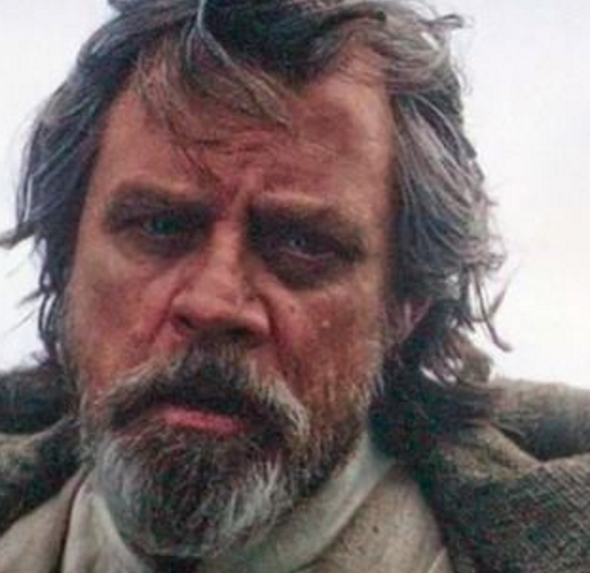
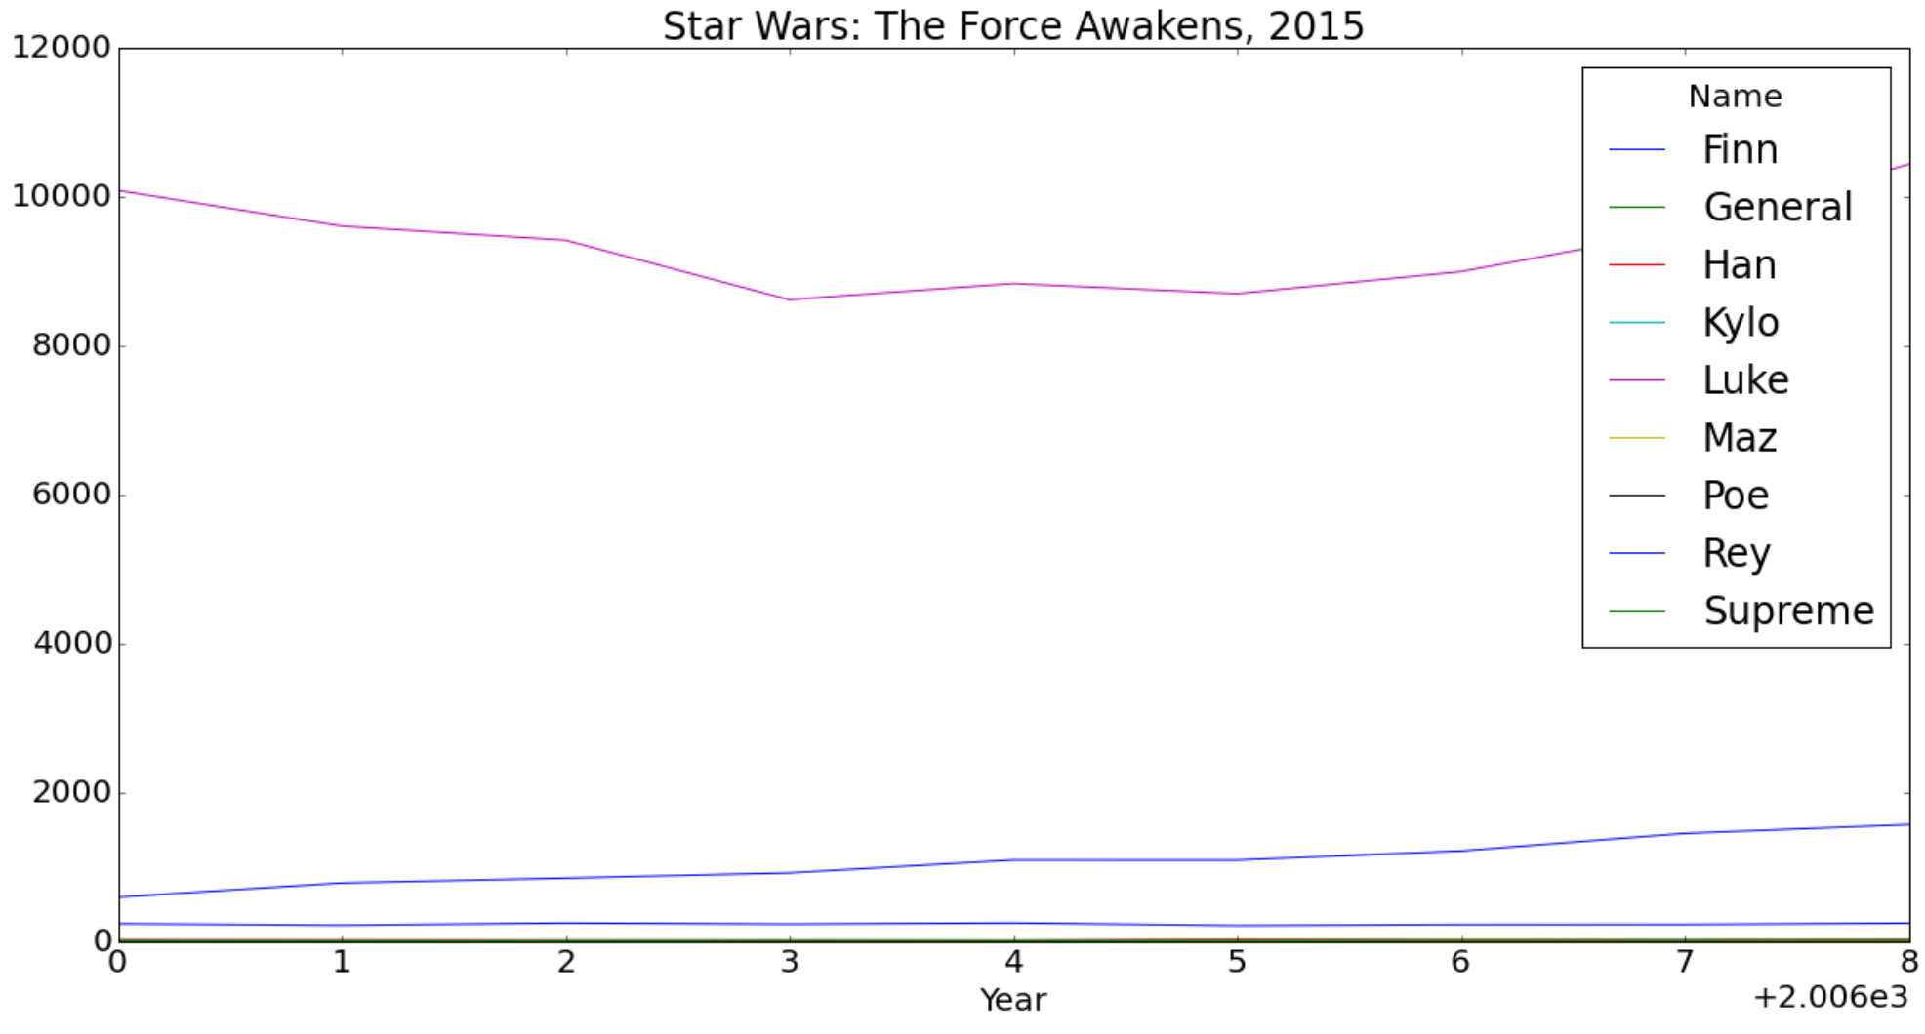
Baby Name vs Movie Characters
Luke Skywalker
Star Wars Episodes
IV - A New Hope 1977
V - The Empire Strikes Back 1980
VI - Return of Jedi 1983
I - The Phantom Menace 1999
II - Attack of the Clones 2002
III - Revenge of the Sith 2005
VII - The Force Awakens 2015

Slide 23
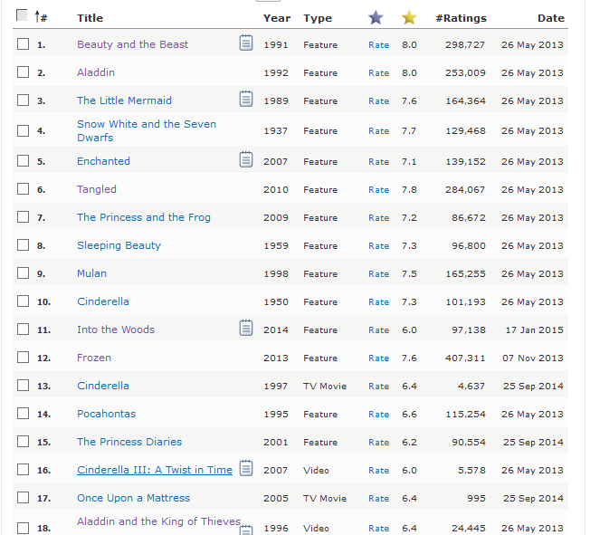
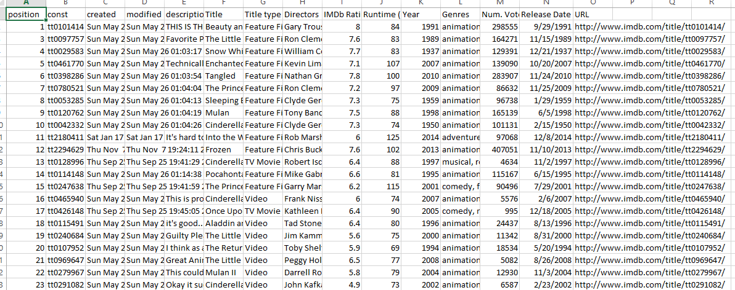
Baby Name Popularity vs Disney Characters

Slide 24
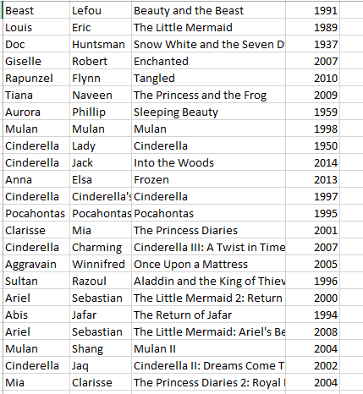
Baby Name Popularity vs Disney Characters
The data that retrieved from the IMDB pages using R program. The data has been cleaned to be used in this analysis.

Slide 25
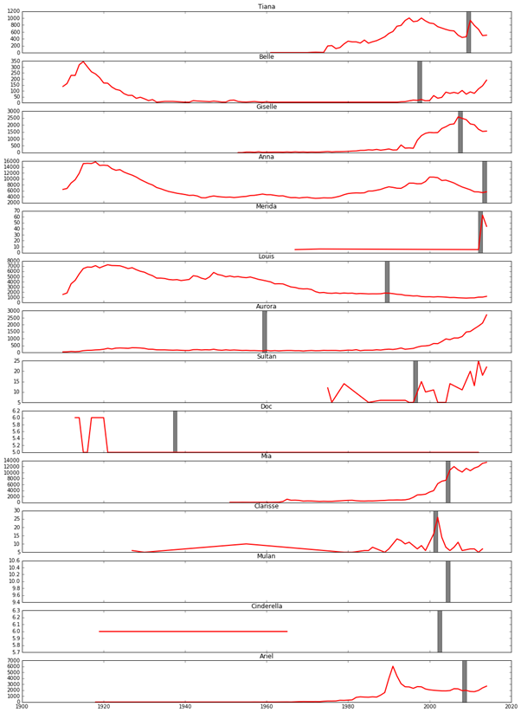
Baby Name Popularity vs Disney Characters
First Character
Most of characters influence the baby names such as ('Tiana', 'Belle','Giselle', 'Sultan', 'Mia', 'Merida', 'Clarisse')
Other don't affect the baby names such as ('Cinderella', 'Aurora').
Some of them don't appear in the original data set.

Slide 26
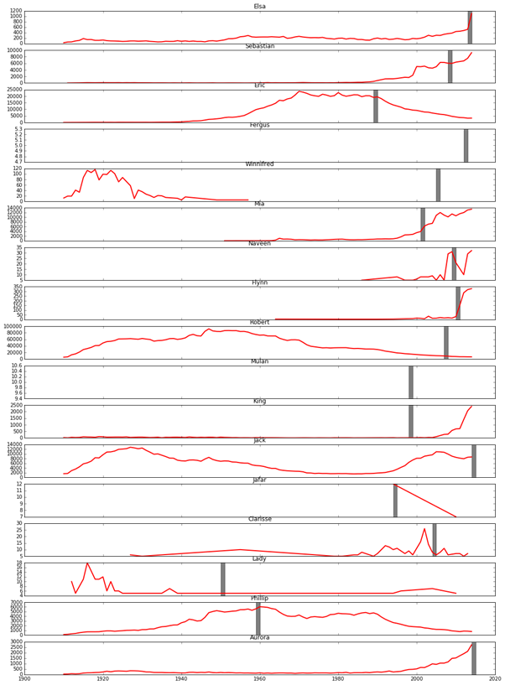
Baby Name Popularity vs Disney Characters
Second Character
Most of characters influence the baby names such as (Elsa, Sebastian, Mia, Hynn, Jafar)
where other don’t have such influence like (Winnfred)
some other influenced the baby names negatively such as (Naveen).
Some of them doesn’t appear in the original data set like (Fergus).

Slide 27
Conclusion
Presidential approval and baby name rate has some similar trends although it is hard to say that the former is causal of the latter. Future directions could include a more robust analysis looking at lag times and incorporating state level data.
Characters in popular movies do have influence on baby names. It’s easier to observe spikes for uncommon names. It’s hard to observe common name spikes because they will be diluted by the large population base.
Most of the Disney characters have influence on the baby names. It seems that it is likely to use the Disney characters names for the babies.For the future work, I will analysis the data with each state separately to see if any state follow this trend more than other states.

